Slide 1
BANK ANALYTICS
DASHBOARD
1.REDDY ESWAR THAI BABU
2.SHEETESH KUMAR
3.SHUBHAM RAJENDRA BHUTADA
4.AJITKUMAR KISHOR BHAGATN

Slide 2
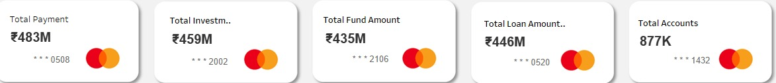
Introduction
The Bank Data Loan Project aims to leverage data analytics to improve loan management processes, enhance risk assessment, and optimize loan offerings for better customer satisfaction and profitability.

Slide 3
01
02
03
K P I ‘ S
DASHBOARDS
CONCLUSION
KPI”S ARE THE KEY PERFORMANCE INDICATORS WHICH WAS GIVEN IS EXPLAIN IN NEXT 5 PAGES
AS PER MY INSIGHTS EXCEL,TABLEAU,POWERBI
DASHBOARDS HAVE BEEN CREATED
THERE IS A CONCLUSION WHICH CAN USE FOR THIS PROJECT

Slide 4
COMING TO KEY PERFORMANCE INDICATORS

Slide 5
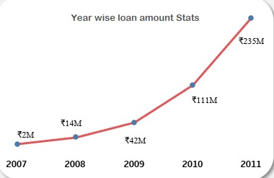
YEAR WISE LOAN AMOUNT STATS
In 2007, the loan sanction amount was 2219275.
In 2008, the loan sanction amount increased to 14390275.
In 2009, there was a significant increase, with a positive number of 46429825
In 2010, the loan sanction amount rose to 122050200.
In 2011, the loan sanction amount further increased to 260506575.
WE CAN SEE HERE THE YEAR WISE LOAN AMOUNT HAVE BEEN INCREASED

Slide 6
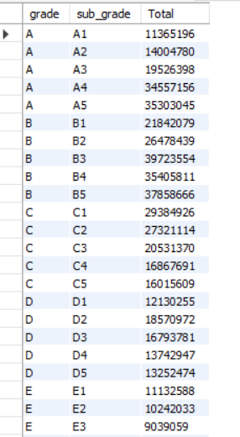
Grade and Sub Grade wise Revol_Bal
Grade A: The total number of students in grade A is 113,651,965. Grade B: The total number of students in grade B is 88,044,567 (21,842,079 in B81, 26,478,439 in B82, and 39,723,554 in B3). Grade C: The total number of students in grade C is 83,237,409 (29,384,926 in C1, 27,321,114 in C2, 20,531,370 in C3, and 16,867,691 in C4). Grade D: The total number of students in grade D is 60,549,477 (12,130,255 in D1, 18,570,972 in D2, 16,793,781 in D3, 13,742,947 in D4, and 13,252,474 in D5). Grade E: The total number of students in grade E is 30,374,620 (11,132,588 in E1, 10,242,033 in E2, 9,039,059 in E3, 7,990,991 in E4, and 7,669,868 in ES). Grand Total: The total number of students across all grades is 375,858,038.

Slide 7
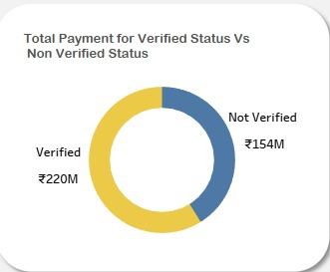
Total Status of Verified and Non Verified
“Total Status of Verified and Non Verified”. The pie chart shows the distribution of verified and non-verified employees.
Verified: The amount sanctioned of verified employees is 220M. There are 59% verified employees.
Non-Verified: The amount of non-verified employees is 154M. There are 41% non-verified employees.

Slide 8

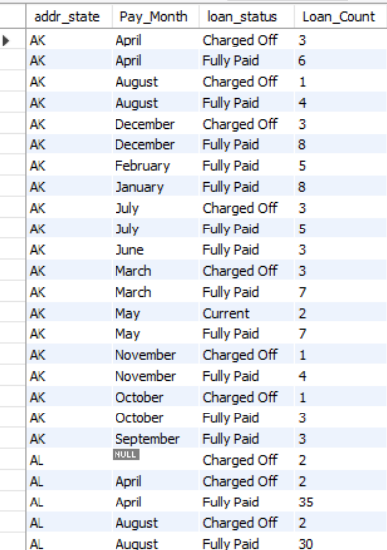
State Wise and month wise loan status
The data appears to be sorted by state, then by month, and then by loan status.
There are more loans with the status "Fully Paid" than "Charged Off".
It is important to note that I cannot tell from this data what the total amount of the loans is, or how much money has been charged off.

Slide 9
Home ownership Vs last payment date stats
home ownership rates in the US by last payment date (2008-2014). It reveals a potential shift away from full home ownership. The number of renters (RENT) steadily increased, while homeowners with no mortgage (OWN) decreased. Mortgage ownership (MORTGAGE) remained flat, and the number of unoccupied homes (NONE) dipped. This suggests economic factors may be influencing people to rent instead of buying a home outright

Slide 10
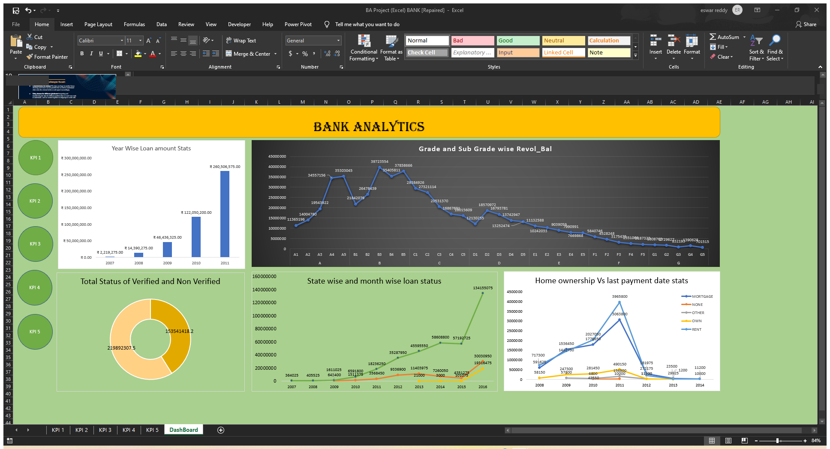

Slide 11
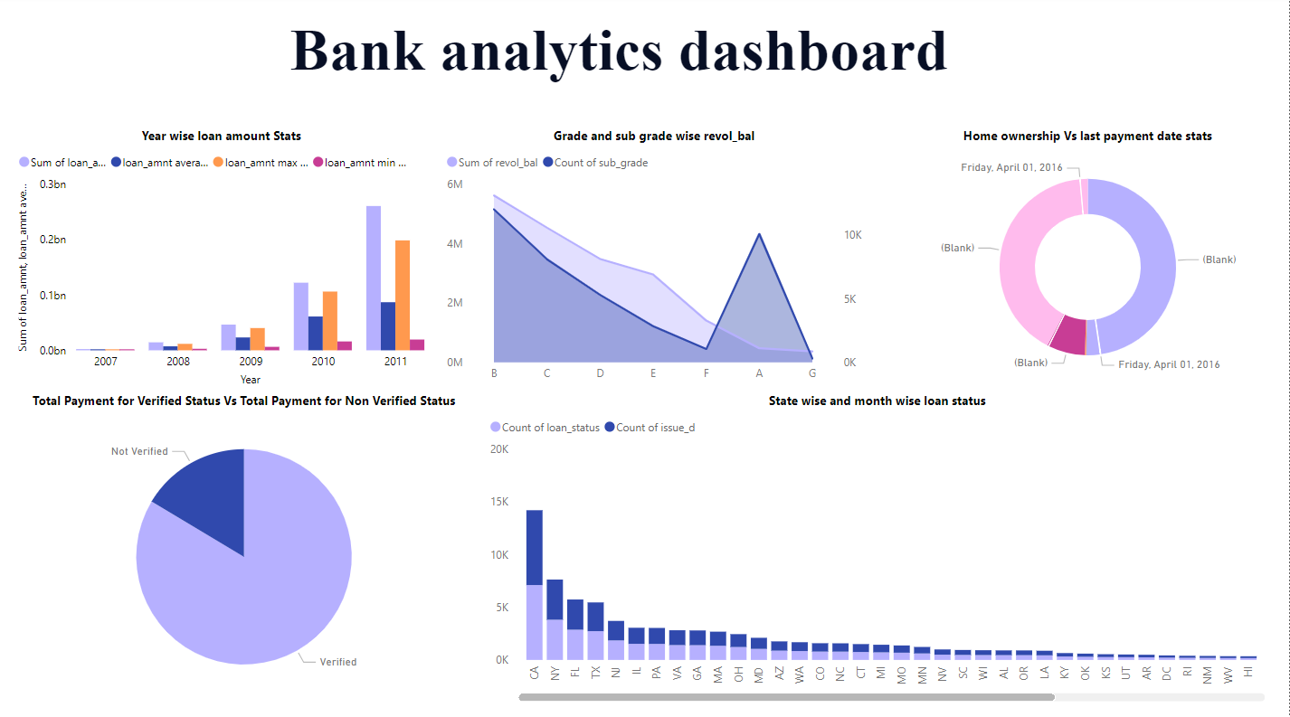

Slide 12
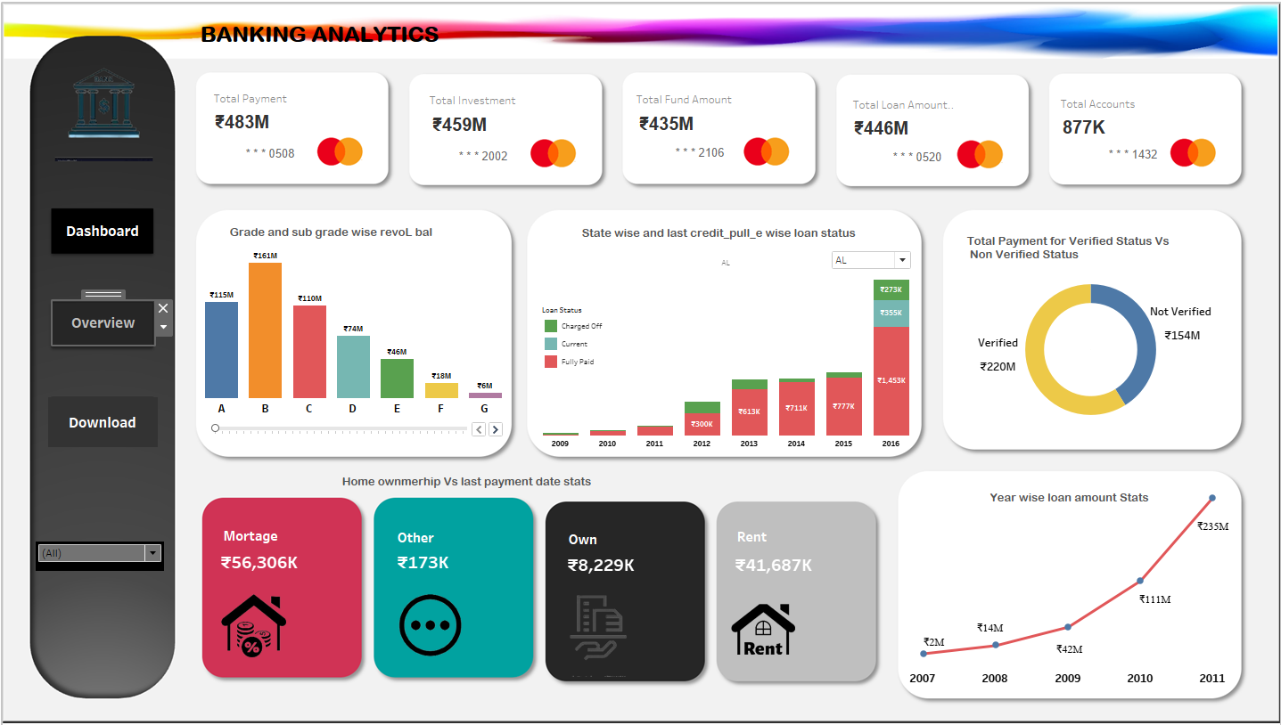

Slide 13
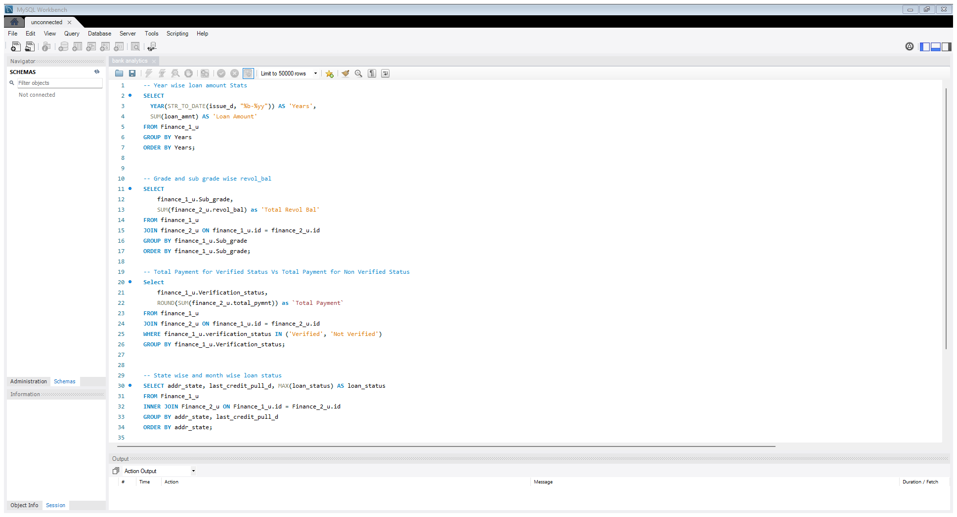

Slide 14
EXHORTATIONS:
Data Integration and Transformation:
Challenge: The project faced difficulty in integrating and transforming data for various platforms like Excel, MySQL, Power BI, and Tableau.
Suggestion: Develop a standardized process for data transformation across platforms to ensure consistency and accuracy.
Enhanced Risk Assessment:
Observation: The data analysis indicated areas for improved risk assessment, especially concerning loan defaults.
Suggestion: Implement advanced risk assessment models using machine learning to predict loan defaults and optimize loan approval processes.
Improved Customer Segmentation:
Observation: Different loan grades and states showed varying behaviors.
Suggestion: Utilize customer segmentation strategies to tailor loan products and offerings based on demographic and behavioral data.
Optimization of Loan Offerings:
Observation: Trends in loan amounts and statuses across states and time periods were identified.
Suggestion: Use these trends to create targeted loan products that meet the specific needs of different customer segments and states.
THINGS THAT NEED TO BE DEVELOPED IN THIS PROJECT THIS MEANS SUGGESTIONS .

Slide 15
CONCLUSION :
The bank analysis project successfully utilized data analytics to enhance loan management and risk assessment processes. Key insights were gained into loan trends, customer segmentation, and the effectiveness of verification processes. By addressing the challenges faced, such as data integration and the need for improved risk models, the project suggests a path forward that includes standardizing data processes, refining risk assessment models, and leveraging advanced visualization tools. These steps are expected to optimize loan offerings, improve customer satisfaction, and enhance overall profitability for the bank

Slide 16
THANKS!
1.REDDY ESWAR THAI BABU
2.SHEETESH KUMAR
3.SHUBHAM RAJENDRA BHUTADA
4.AJITKUMAR KISHOR BHAGAT

